Slide 1
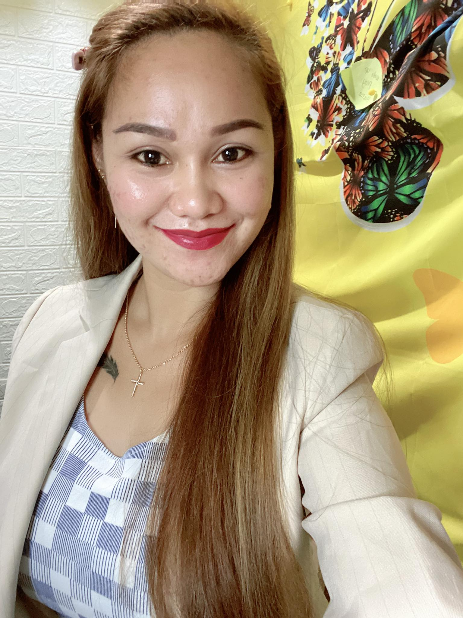

Almera kisteria Jutag
Former OFW
Resigned Government Employee
Registered Midwife
Valencia,Bukidnon

Slide 3


DIGITAL PROGRAM OWNED BY

Slide 4

OBJECTIVE is to Help you
INCREASE &
MANAGE your FINANCES

Slide 5


Drive your
Own Car
Personal &
Family Savings
Travel with
the Family
Be
DEBT FREE
Live your
Dream House

Slide 6

DIGITAL PROGRAM POWERED BY BIG, STABLE INTERNATIONAL FILIPINO OWNED COMPANY ROYALE

Slide 7
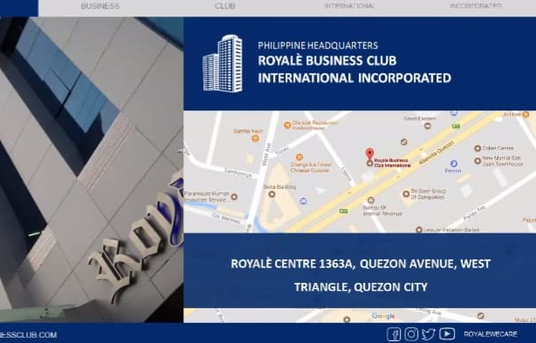

Slide 8
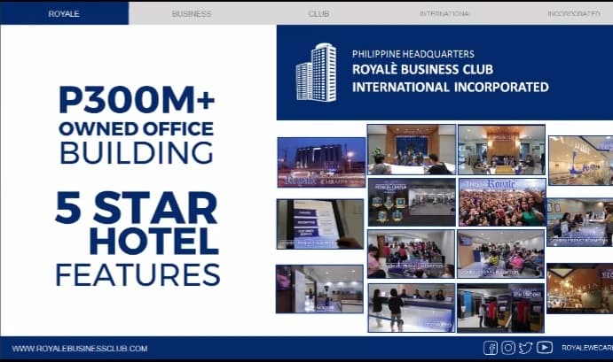

Slide 9
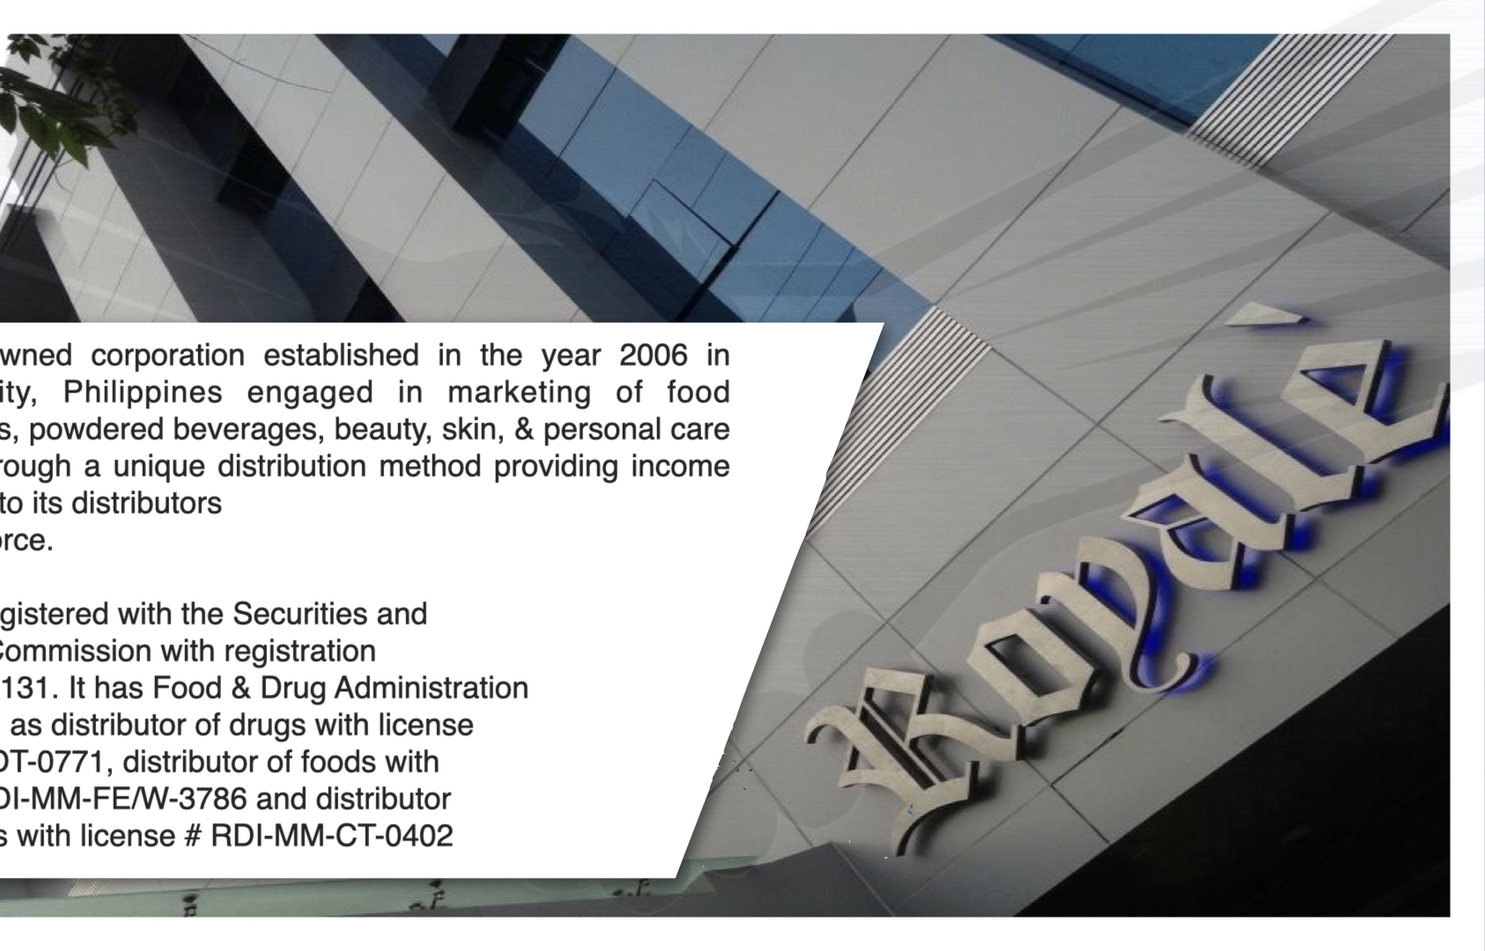

Slide 10
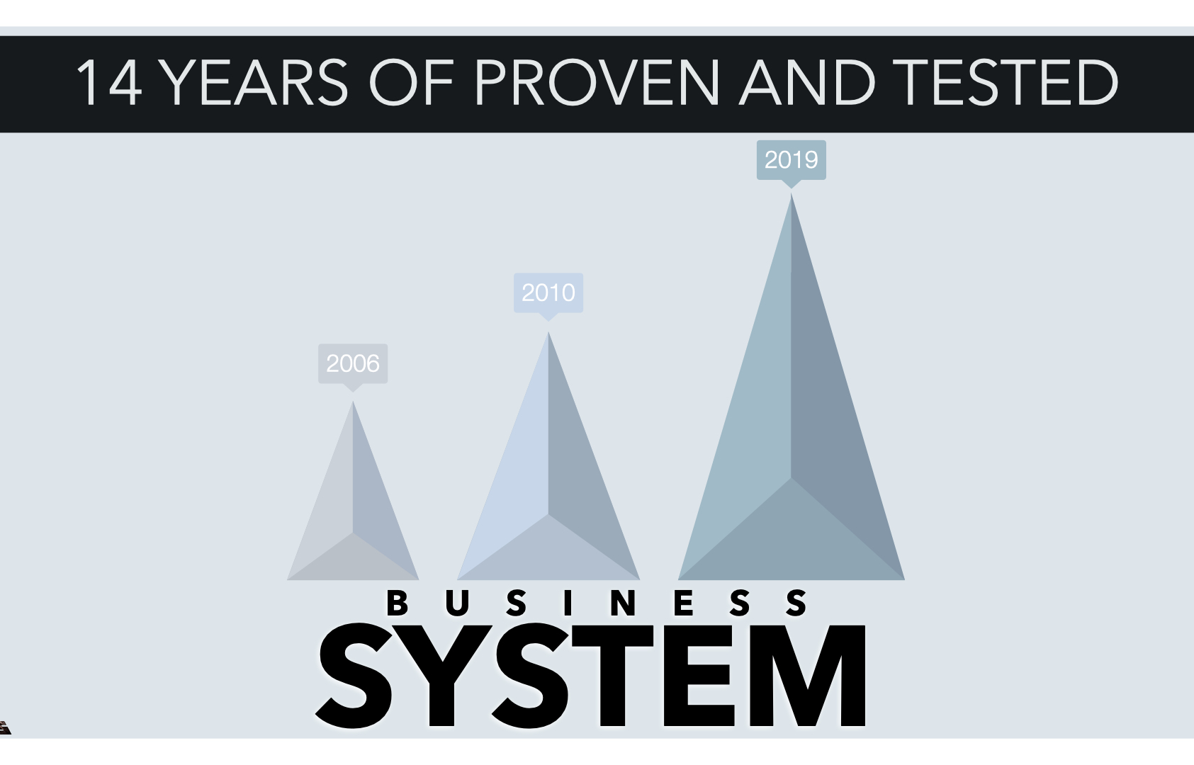
15

Slide 11
WILL PROVIDE
A BUSINESS SYSTEM
TO INCREASE FINANCES

Slide 12
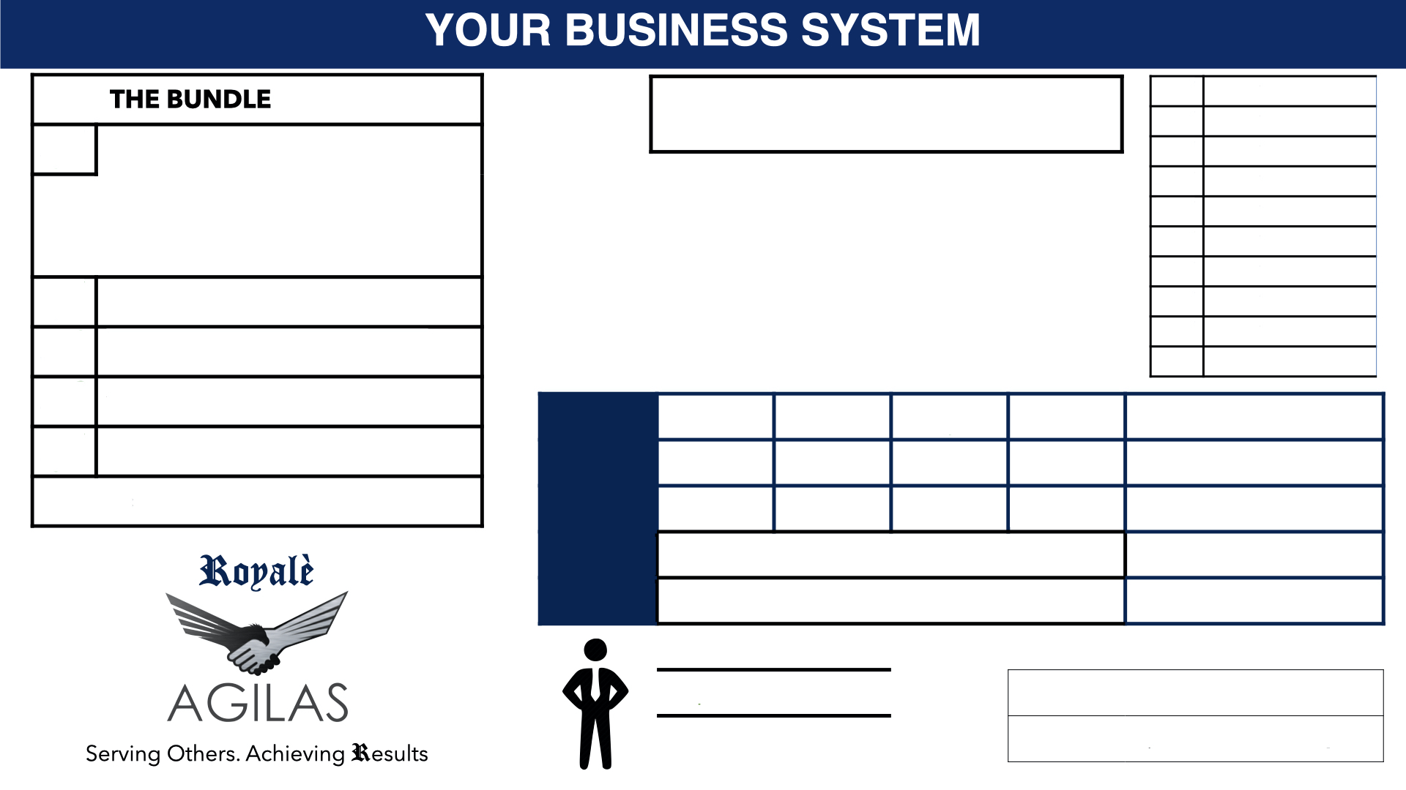

Slide 13
HOW TO START?
AVAIL THE BUNDLE
INCLUSIONS OF THE BUNDLE
BUSINESS System:
Unique Compensation Plan
Personal Online Account
Official Web Page
Personal Training & Coaching
P138K + Worth of Products

Slide 14

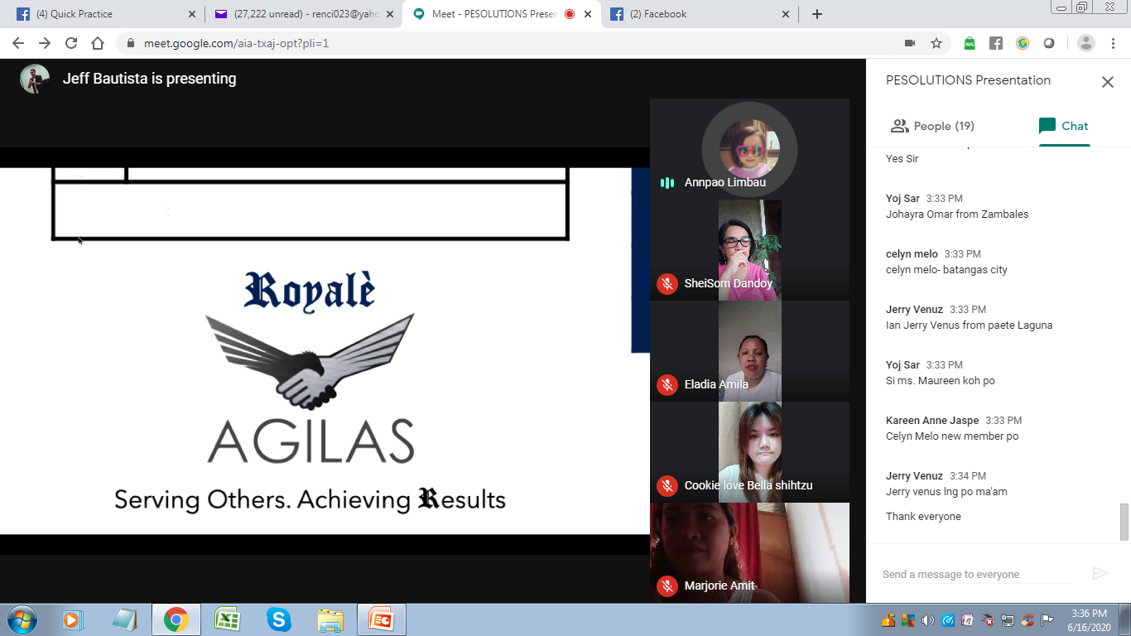

Slide 15
HOW TO START?
ENROLL and GET THE BUNDLE
INCLUSIONS OF THE BUNDLE:
BUSINESS System:
Unique Compensation Plan
Personal Online Account
Official Web Page
Personal Training & Coaching
P138K + Worth of Products
P12,000 Outright Bonus Income
P1,000,000 BPI Group Insurance
Lifetime & Transferrable System
FOR ONLY: P130,620
The Value of your Money is over
P1M or 881% Increase PLUS the BUSINESS SYSTEM
with UNLIMITED POTENTIAL INCOME

Slide 16

Good news!!!
We can avail the BUSINESS
P5,000
per month only
Copy the practices of the Business People by using OPM or Other People’s Money in a form of LOAN from Banks, Cooperatives, Lending, GSIS, SSS, AFPSLAI, etc…

Slide 17

Your
1st
Million
Let’s EARN
3-6 Months

Slide 18


FINANCIAL EDUCATION
NEVER DEPEND ON A SINGLE INCOME
CREATE MULTIPLE STREAMS OF INCOME

Slide 19

Is Proven & Tested
Digital Program in partnership with ROYALE;
using our MARKETING TOOLS you’ll Earn
ACTIVE & PASSIVE INCOME.

Slide 20

HOW THE BUSINESS
SYSTEM WORKS?
Php 11,550
SMAC Purchased P200 = 1PT = P1
2,100 PTS = P2,100
+ 1,050 Points
P16,800
Bundle 2,100 Pts =

Slide 21

HOW THE BUSINESS
SYSTEM WORKS?
YOU
11,550
11,550
11,550
11,550
16,800
16,800
16,800
16,800
12,000
ANN
1,050 Pts
BRIAN
1,050 Pts
CARL
1,050 Pts
DINA
1,050 Pts
125,400
LEVEL 1
LEVEL 2 4 4 4 4
268,800
LEVEL 3 16 16 16 16
1,075,200
LEVEL 4
4,300,800
LEVEL 5
UNLIMITED INCOME

Slide 22
REALIZATION
Employment
P20,000 a Month
P240,000 a Year
X 3 years =
P720,000 only!
YOU
11,550
11,550
11,550
11,550
16,800
16,800
16,800
16,800
12,000
ANN
1,050 Pts
BRIAN
1,050 Pts
CARL
1,050 Pts
DINA
1,050 Pts
125,400
LEVEL 1
LEVEL 2 4 4 4 4
268,800
3 -6
Months
LEVEL 3 16 16 16 16
1,075,200
LEVEL 4
4,300,800
LEVEL 5
UNLIMITED INCOME

Slide 23
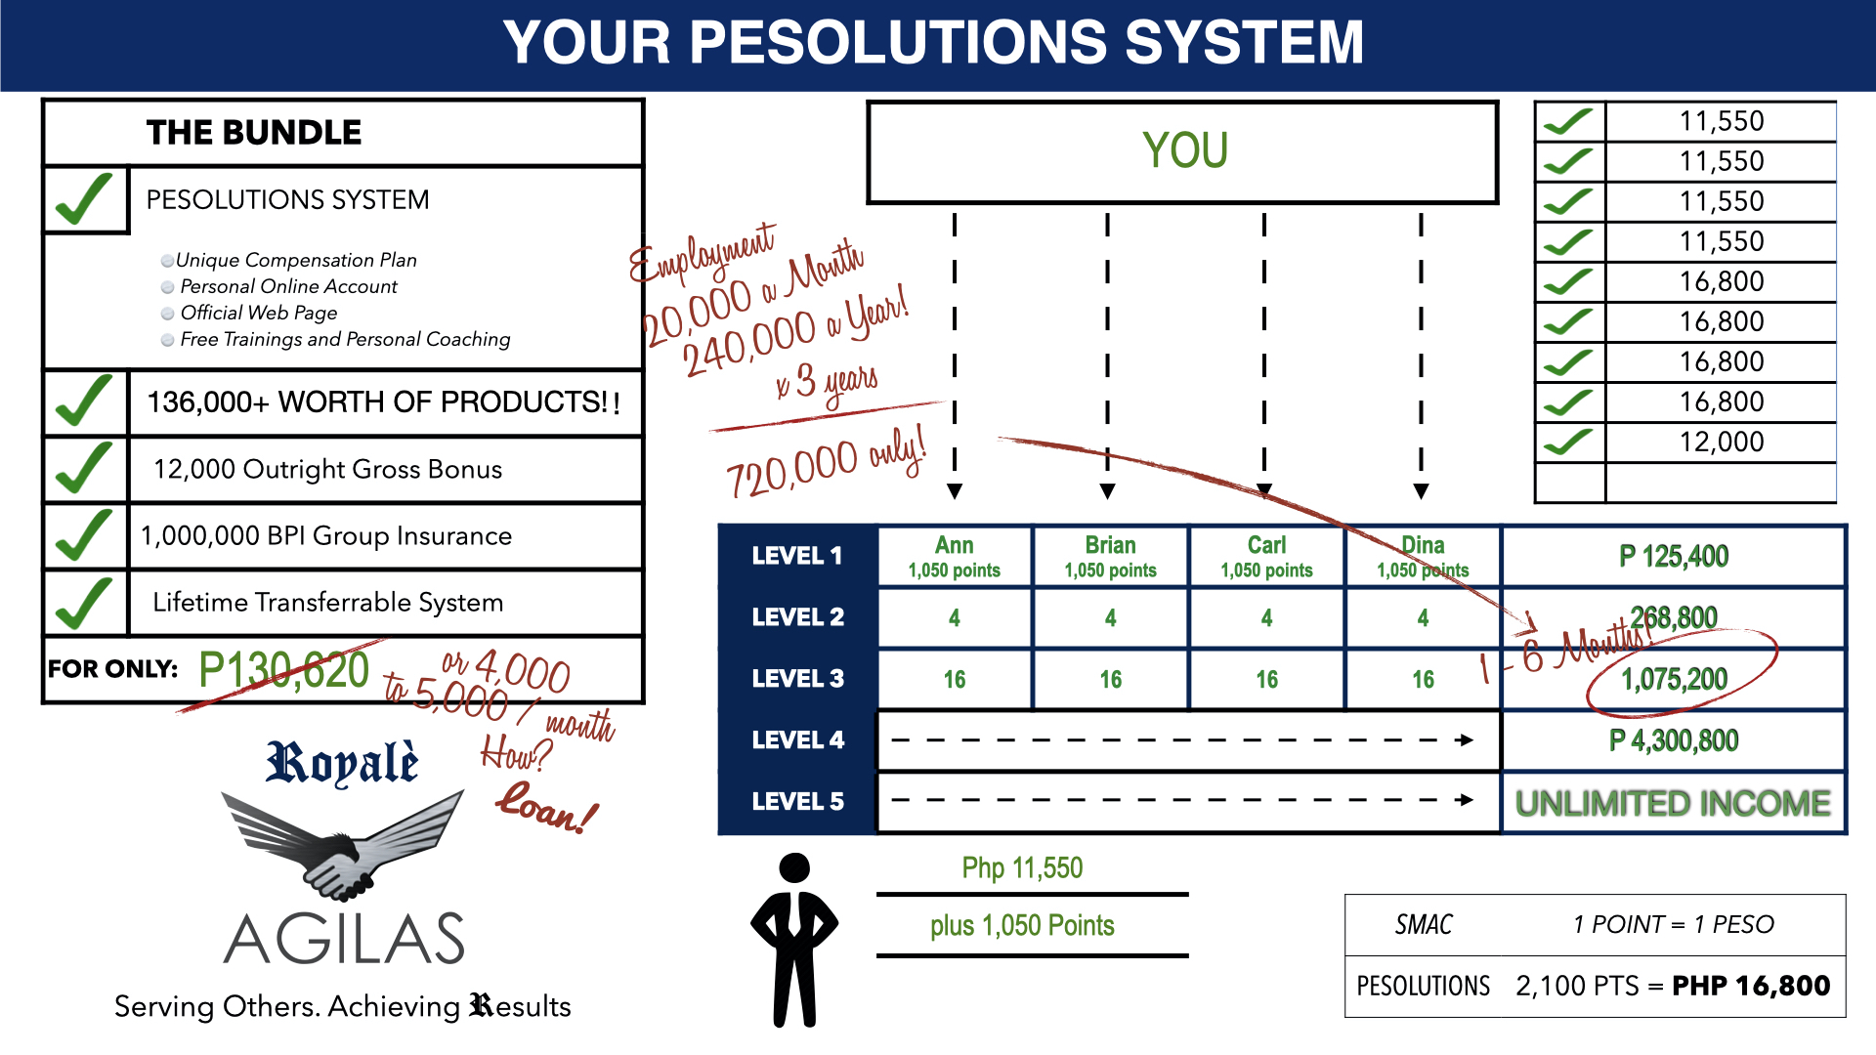
DID I PROVIDE YOU A
SOLUTION TO YOUR DREAMS/GOALS?
BUSINESS System:
138+ worth of products

Slide 24
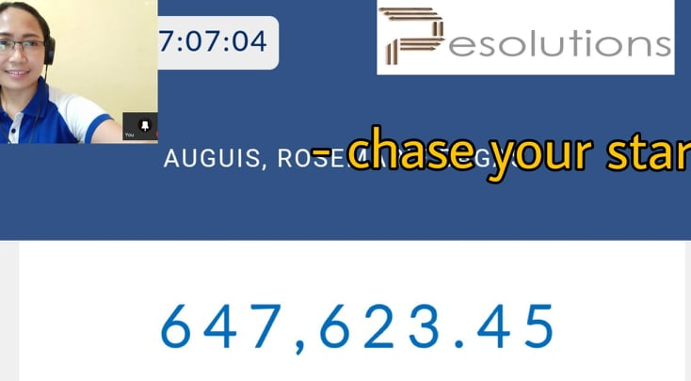
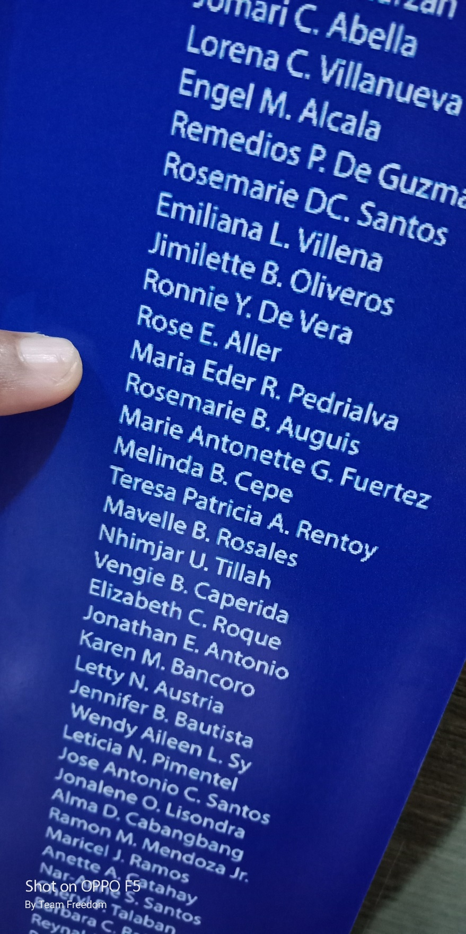
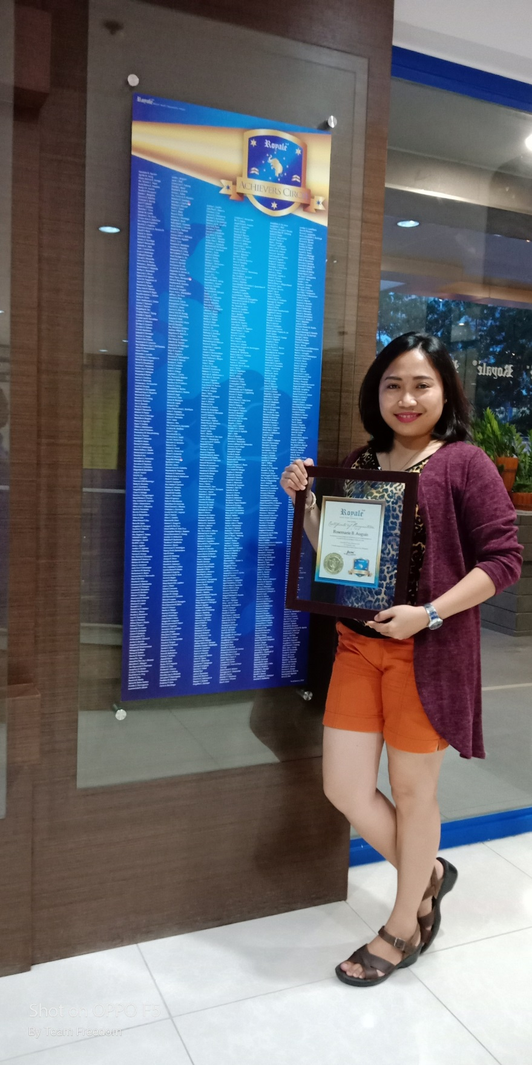
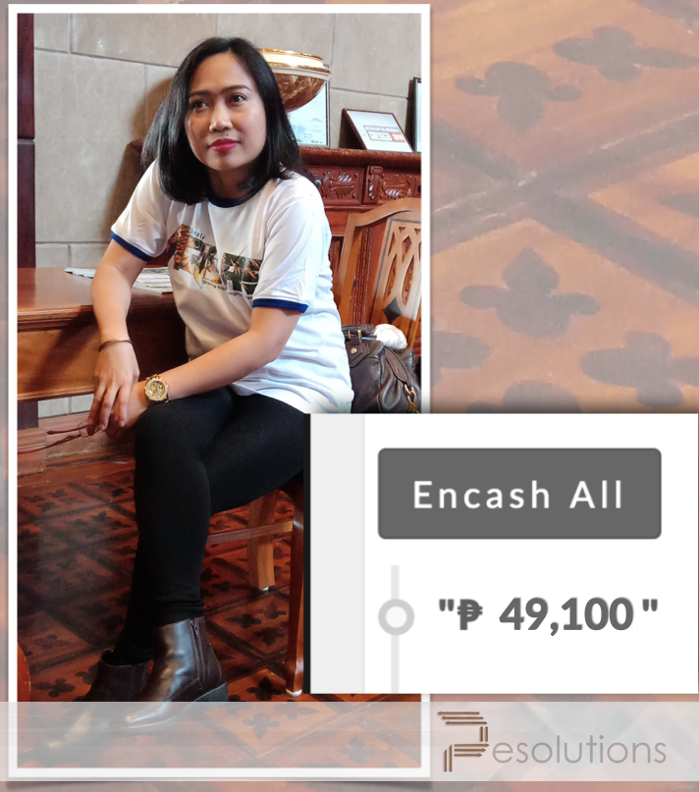
PART TIME

Slide 25
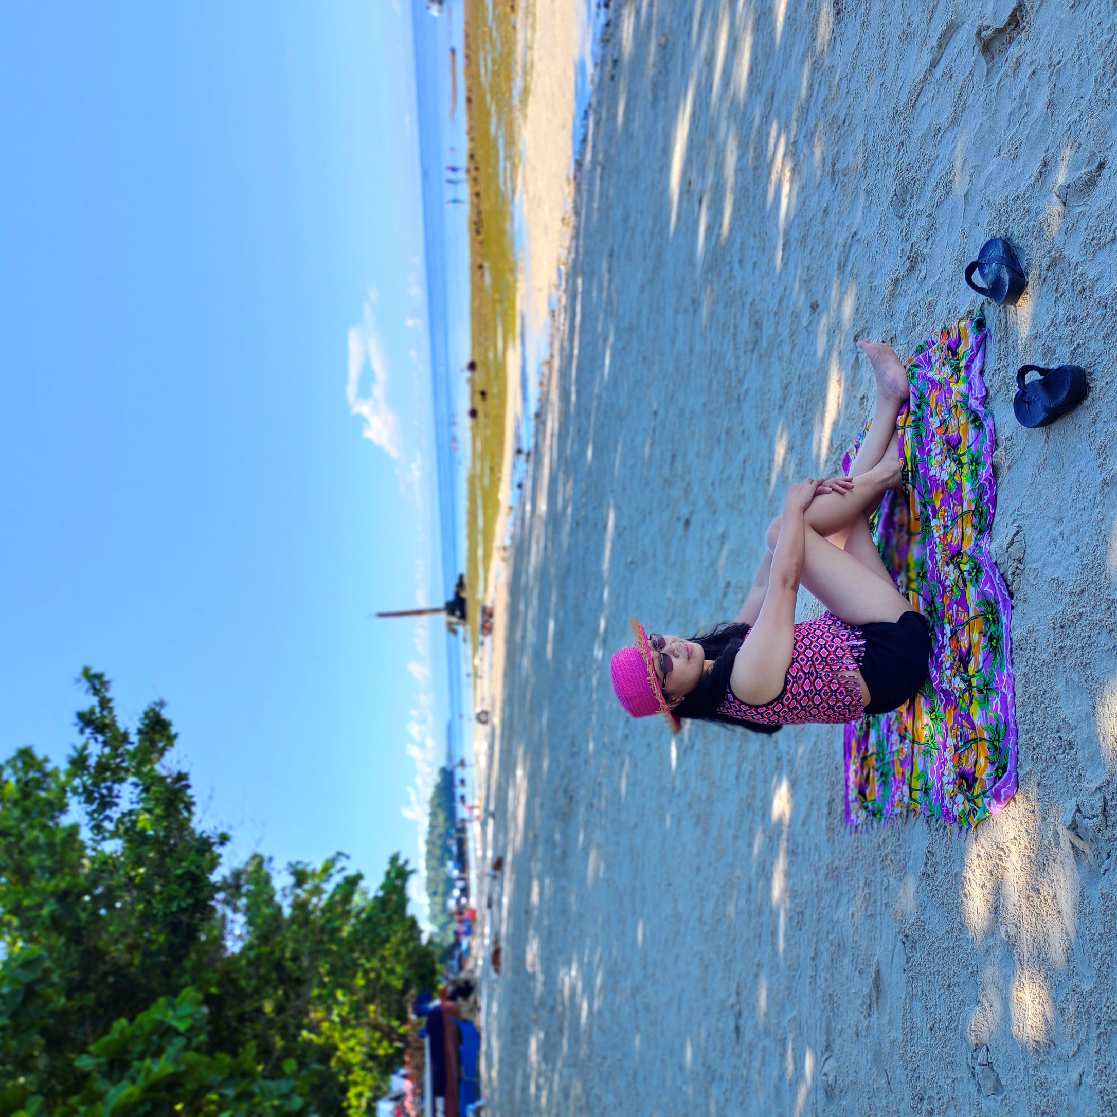

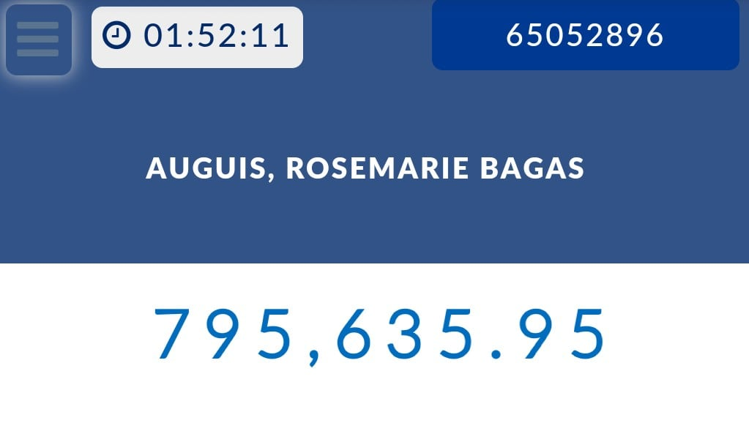

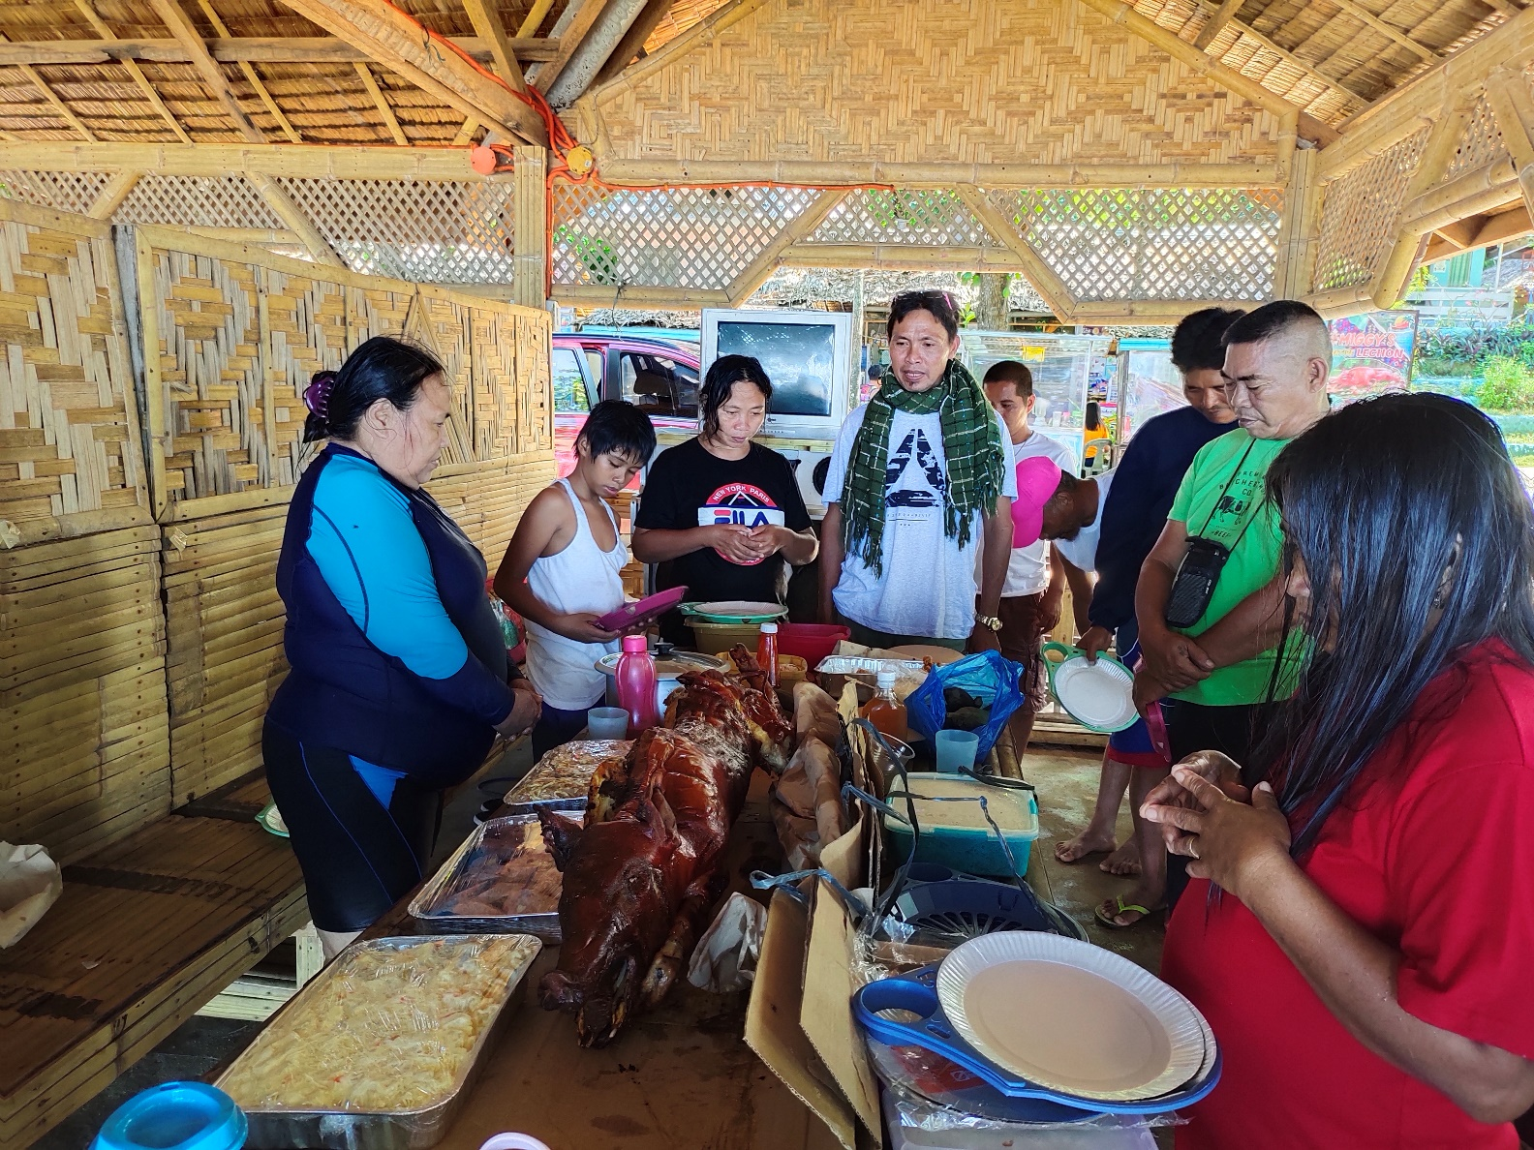

FAMILY

Slide 26
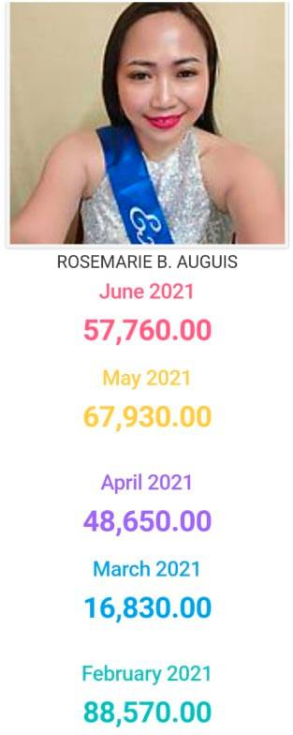
Resigned private
Employee
January 15, 2021
FULLTIME Entrepreneur
February 2021 to June 10, 2021
Total income:
279,740.00

Slide 27






AGILAS ALLIANCE
Head Coach
President Circle
2020 top #2
AGILAS
Grand Coach
Chairman Circle
EXECUTIVE CIRCLE
March 12, 2021 at Marriotte Hotel, Pasay Manila
Wife of top #2
Top #15
Wife of top #1
top #6
AGILAS FAMILY

Slide 28
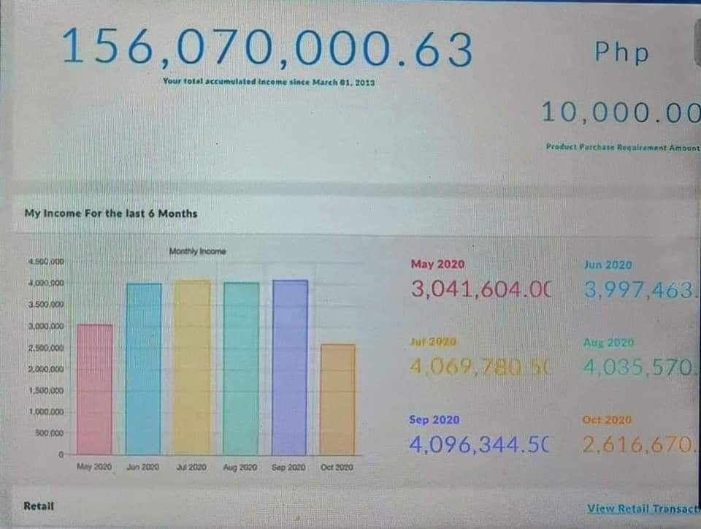

TOP 1 for 4 Consecutive Years
Mr. Jason Dela Cruz
34 Years Old

Slide 29

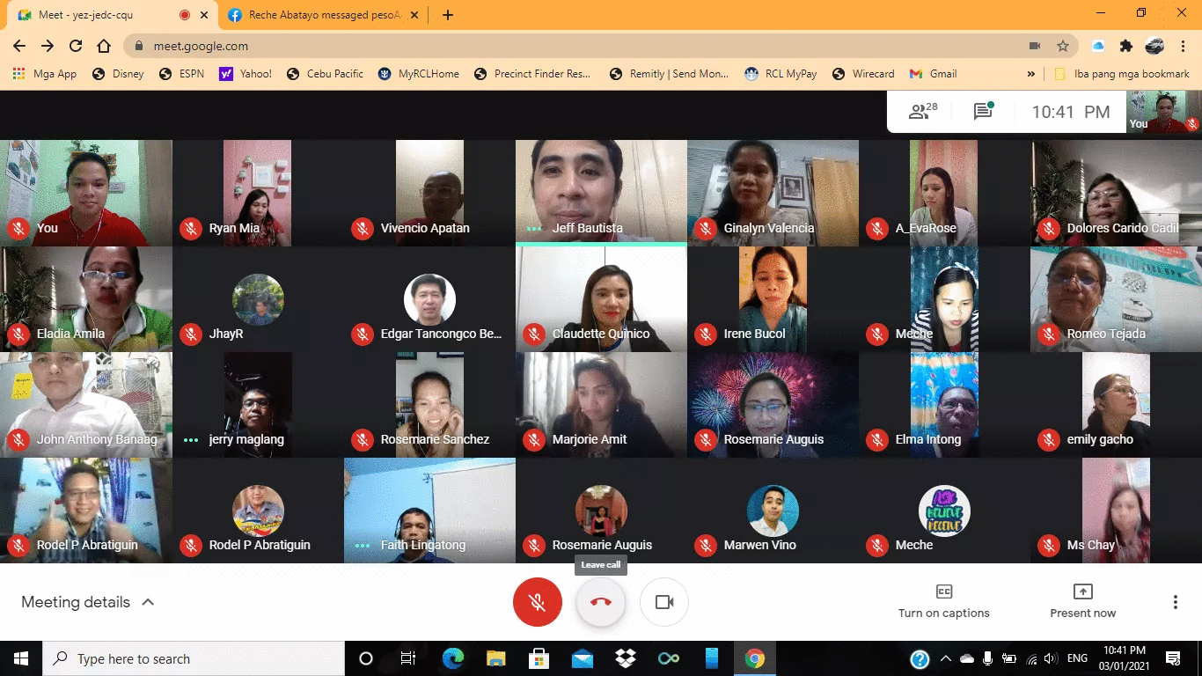

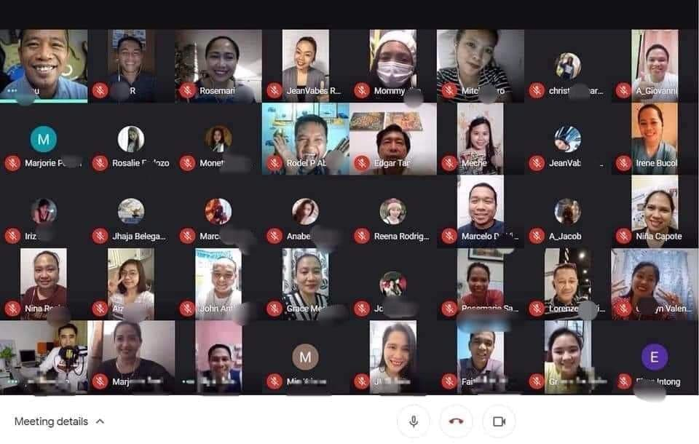
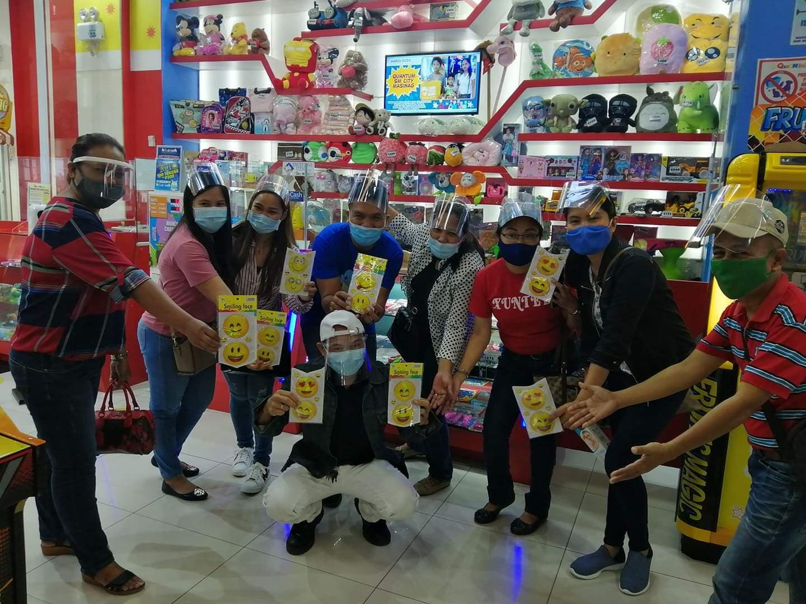
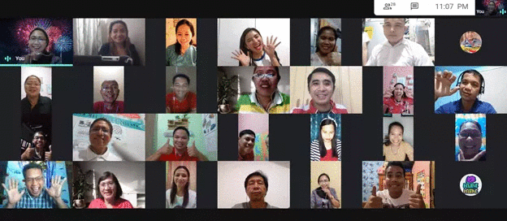
2nd FAMILY
FREEDOM
TEAMWORK

Slide 30



Slide 31


